Slide 1
Stat 6.2.0 – What’s New! December 6, 2018 Vahid Rahimi Software Dev Senior Engineer Yuri Denshchik Software Dev Senior Engineer

Slide 2
Agenda
New features
Enhancements
Resolved issues
Updates in the Release Notes
Q&A

Slide 3
New features
Automated Pre and Post Migration Steps for custom commands
Run custom command with Business Rules
Merged CSR Edit and CSR Change Management Windows
Perform Planned Migration using REST Web Services
Custom Rules when setting Default CSR Owner
REST Web Services API for third party applications
New http/https Configuration for Stat Central Agent
LDAP access with samAccountName

Slide 4
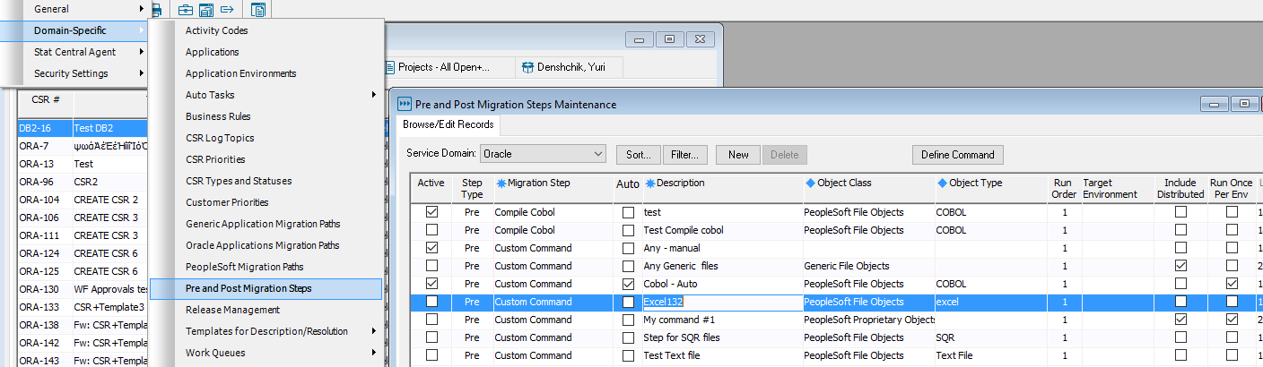
Automated Pre and Post Migration Steps for custom commands
Combined Pre and Post Migration Steps maintenance windows
“Auto” checkbox for custom commands

Slide 5
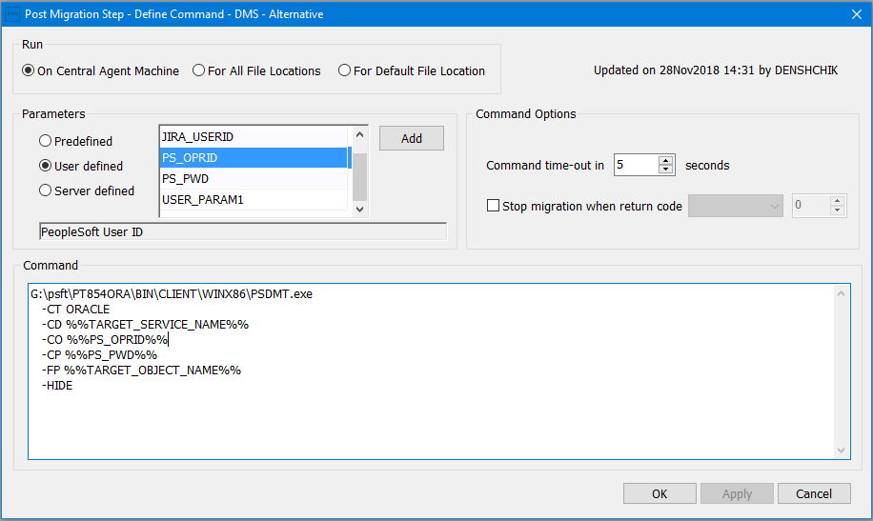
Automated Pre and Post Migration Steps for custom commands (continue)
Redesigned Command editor

Slide 6
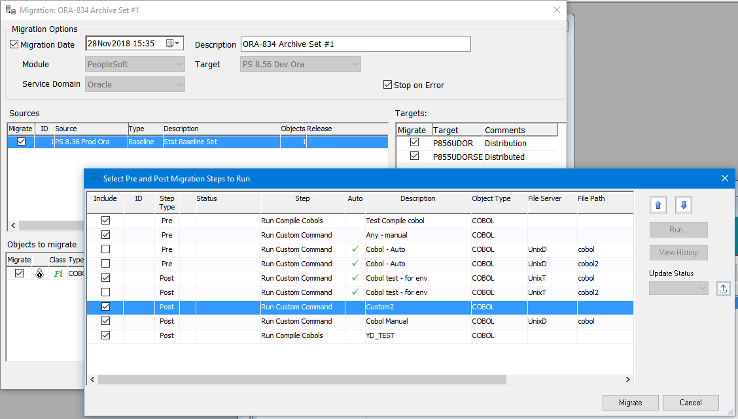
Automated Pre and Post Migration Steps for custom commands (continue)
Select Pre and Post migration steps

Slide 7
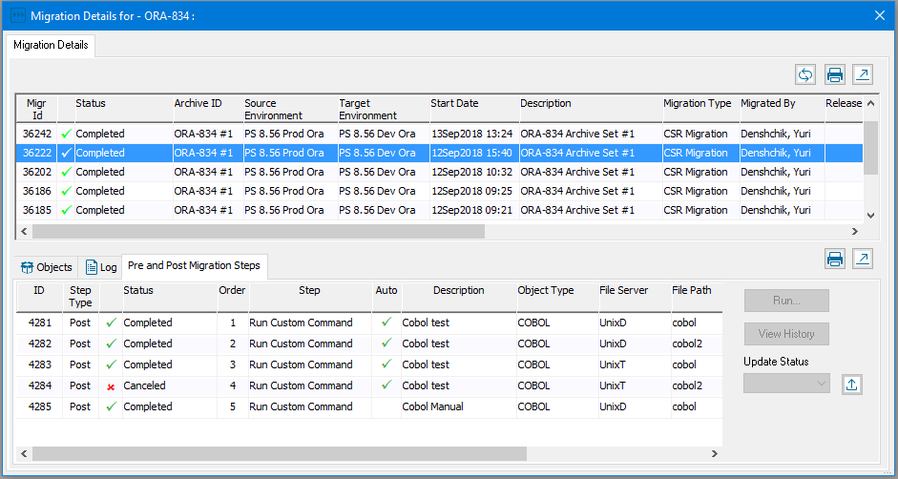
Automated Pre and Post Migration Steps for custom commands (continue)
View and Execute Pre and Post migration steps from Migration Details Window

Slide 8
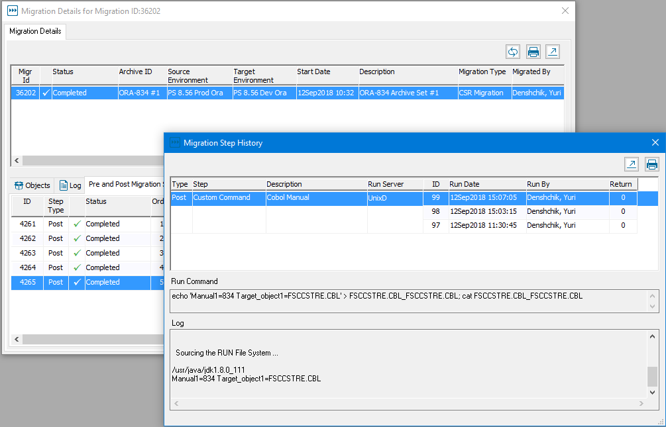
Automated Pre and Post Migration Steps for custom commands (continue)
Migration Step History

Slide 9
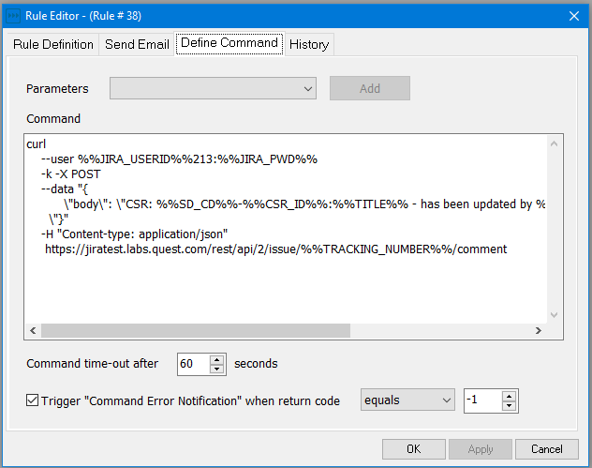
Run custom command with Business Rules
Configurable CSR and user-defined parameters
Configurable error condition for run command with Email notification
View run command historical information

Slide 10
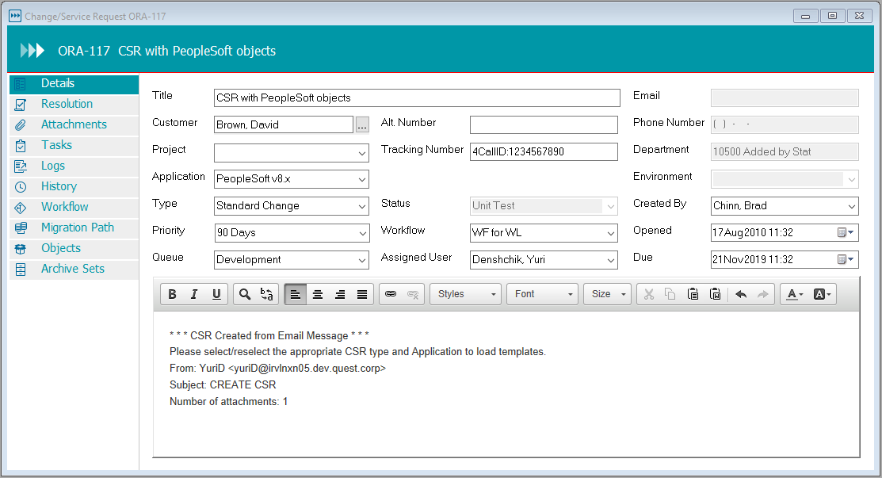
Merged CSR Edit and CSR Change Management Windows
Notes:
Similar to Web Client
Improved performance on open CSR
Modernized CSR sections

Slide 11
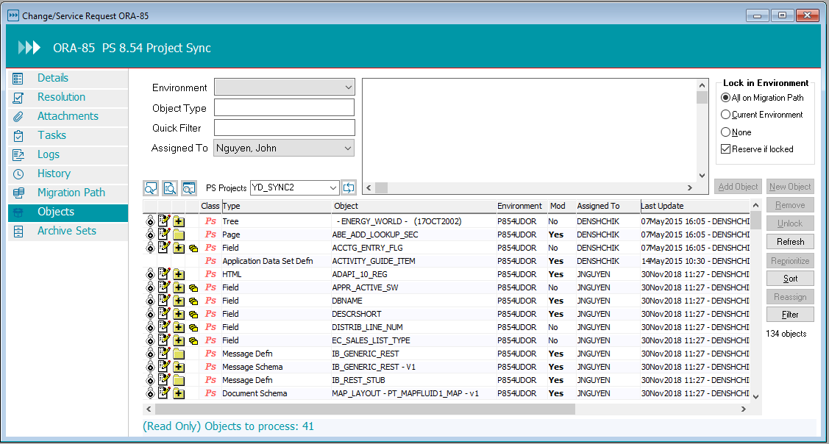
Merged CSR Edit and CSR Change Management Windows
Objects tab
Notes:
Similar to Web Client
Improved performance on open CSR
Modernized CSR sections

Slide 12
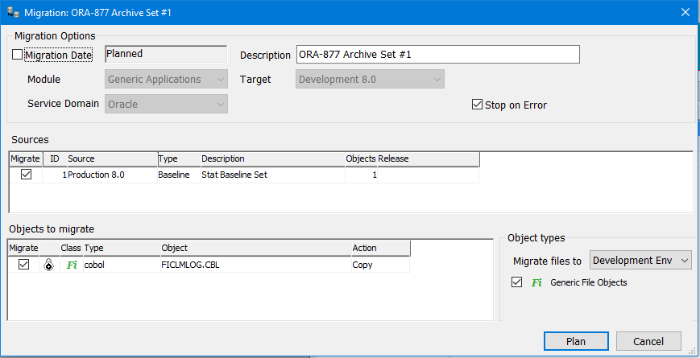
Perform Planned Migration from a third-party tool
Set up the migration as a Planned one by unchecking the checkbox next to Migration Date
Migration can be started by calling REST Web Services from outside Stat

Slide 13
Perform Planned Migration from a third-party tool
REST API to retrieve a list of Planned migrations
GET /api/csrMigrations?sdCd=&processStatus=&migrId=&migratorId=&targetDb=
GET /api/csrMigrationObjects?migrId=
REST API to start the Planned migration
PUT /api/csrMigrationPlannedSubmit/<migrId>
Notes:
Retrieve list of migrations by using one or more criteria

Slide 14
Custom rules when setting default CSR Owner
New global parameter “CSR default owner rule“ that defines the rule on which CSR default owner is calculated by Stat Used when
Create new CSR
Changing CSR Queue
CSR Workflow Status transfer
Auto advance CSR Workflow
CSR Owner can be defaulted to
Current CSR Owner
Stat Logged in user
Queue Owner
CSR Creator

Slide 15
REST Web Services API for third party applications
API for CSR retrieval, creation and update
Retrieval of CSR Attachments, Logs, Tasks
Perform patch, migration and workflow transfer approvals
Retrieval of CSR Archive Sets, Archive Set objects
Retrieval list of migrations, migration objects per migration
Initiate planned migrations
http://<serverName>:8080/stat/api/csrs?sdCd=
http://<serverName>:8080/stat/api/myCsrs?sdCd=
http://<serverName>:8080/stat/api/csrAttachments?sdCd=&csrId=
(patch, transfer)
http://<serverName>:8080/stat/api/csrArchiveSets?sdCd=&csrId=
http://<serverName>:8080/stat/api/csrMigrations?sdCd=&processStatus=&migrId=&migratorId=&targetDb= (Any combination)

Slide 16
New HTTP/HTTPS Configuration for Stat Central Agent
Edit standalone.conf/standalone.conf.bat
Set JAVA_HOME, STAT_HOME
Set SERVER_CONFIG=standalone-full.xml for http (Default value)
Set SERVER_CONFIG=standalone-full-https.xml for https
For https, copy their keystore with the certificate to <STAT_HOME>/app/standalone/configuration
Edit standalone-full-https.xml and enter the keystore name and password.
<ssl>
<keystore path="my.jks" relative-to="jboss.server.config.dir" keystore-password="secret"/>
</ssl>
https on Oracle Agent
New parameter in stat.conf
stat.central_agent.protocol:https
https certificate needs to be imported into <JAVA_HOME>/jre/lib/security/jssecacerts file
keytool -v -list -keystore .keystore
keytool -export -keystore my.jks -alias stat_https_client -file mycert.cert
keytool -import -keystore jssecacerts -file mycert.cert -alias stat_https_client –trustcacerts

Slide 17
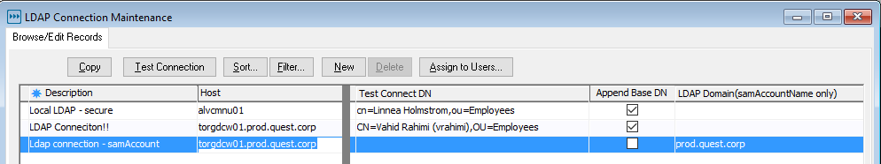
LDAP access with samAccountName
New column on LDAP Connection Maintenance for LDAP Domain
If Test Connect DN is left empty, current logged in userid is used
Or you can enter a valid userid in order to perform a Test Connection
Notes:
- When doing a test connect, if Test Connect DN is left empty, current user id is used to perform the test connect. Otherwise you can enter a valid userid in Test Connect DN to perform the test connect.

Slide 18
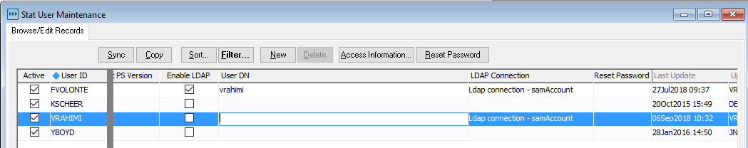
LDAP access with samAccountName
On User Maintenance, you only have to assign the LDAP Connection to each user.
Stat User ID is used to query the LDAP server for a valid password.
Stat user has to match the userid in LDAP server.
You can overwrite the userid by entering a userid into User DN

Slide 19
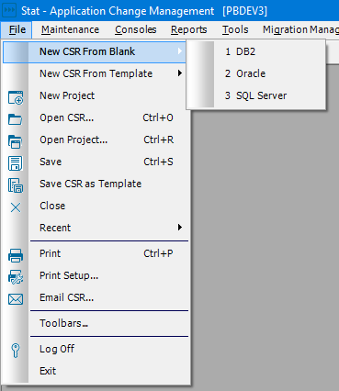
Eliminated “Select Service Domain” dialog
Create New CSR against default Service Domain with one click
Create New CSR from any allowed Service Domain from menu
Notes:
Similar to Web Client
Improved performance on open CSR
Modernized CSR sections

Slide 20
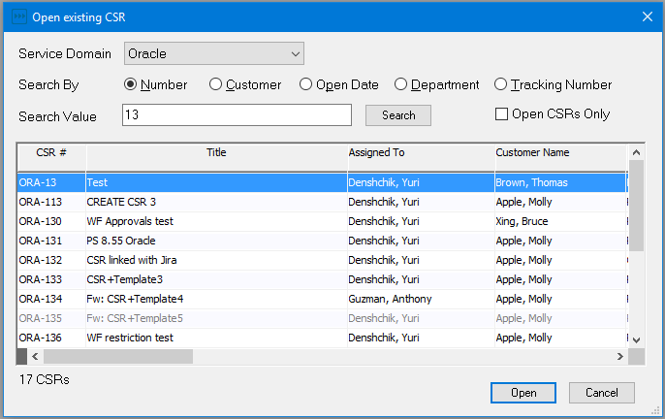
Design and performance improvements of CSR Search Window

Slide 21
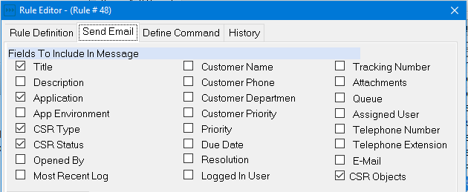
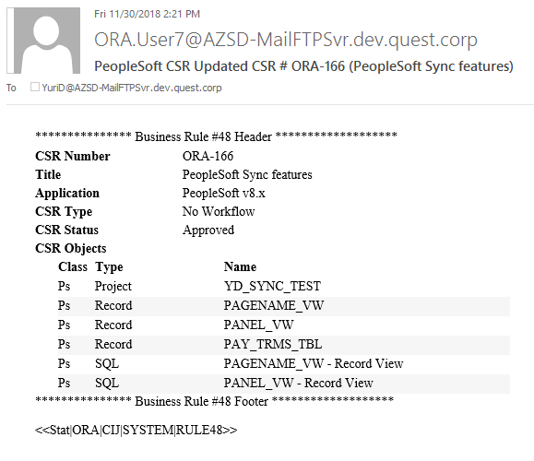
Option to include CSR objects in Business Rule Emails

Slide 22
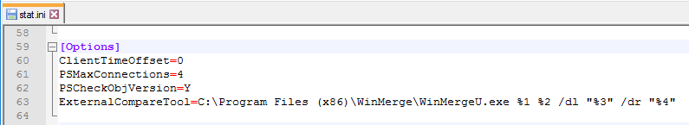
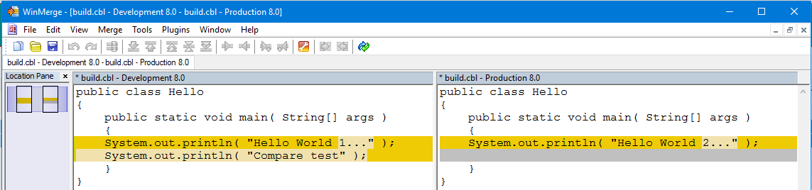
Option to use an external third party compare tool to perform file comparisons

Slide 23
Other Enhancements
New user rights to secure access to all Wizards and Consoles
Changed the description of PeopleSoft "XMLP ..." object types to "BIP…“
Support for the PeopleSoft MAP Store object type
Reduced whitespace in CSR Description and Resolution
Navigate between CSR Description table cells using the Tab key
Ability to Import/Export CSR Statuses
VCM path configuration specific to each object type
Removed all dependencies on port from Stat Window’s client

Slide 24
Resolved Issues
Fixes and third party library updates to cover vulnerability issues
Improved performance in multiple areas including CSR Workflow auto advanced transfers, creating a new CSR, creating a new Archive Set etc.
Prevent previous approval emails from approving/rejecting a CSR's workflow status after the CSR's Status is changed
Fixes for 40 customer issues. Refer to Release Notes for the complete list

Slide 25
Updates in the Release Notes
Central Agent on Weblogic is no longer supported.
Supported PeopleTools versions are 8.54, 8.55 and 8.56
Supported Oracle E-Buisness are 12.1.x and 12.2.x
Stat 6.2 is the last version with 32-bit Windows client support

Slide 26
Q&A Visit the Stat User Community: www.quest.com/community/products/stat

Slide 27
Thank You!

